Slide 1
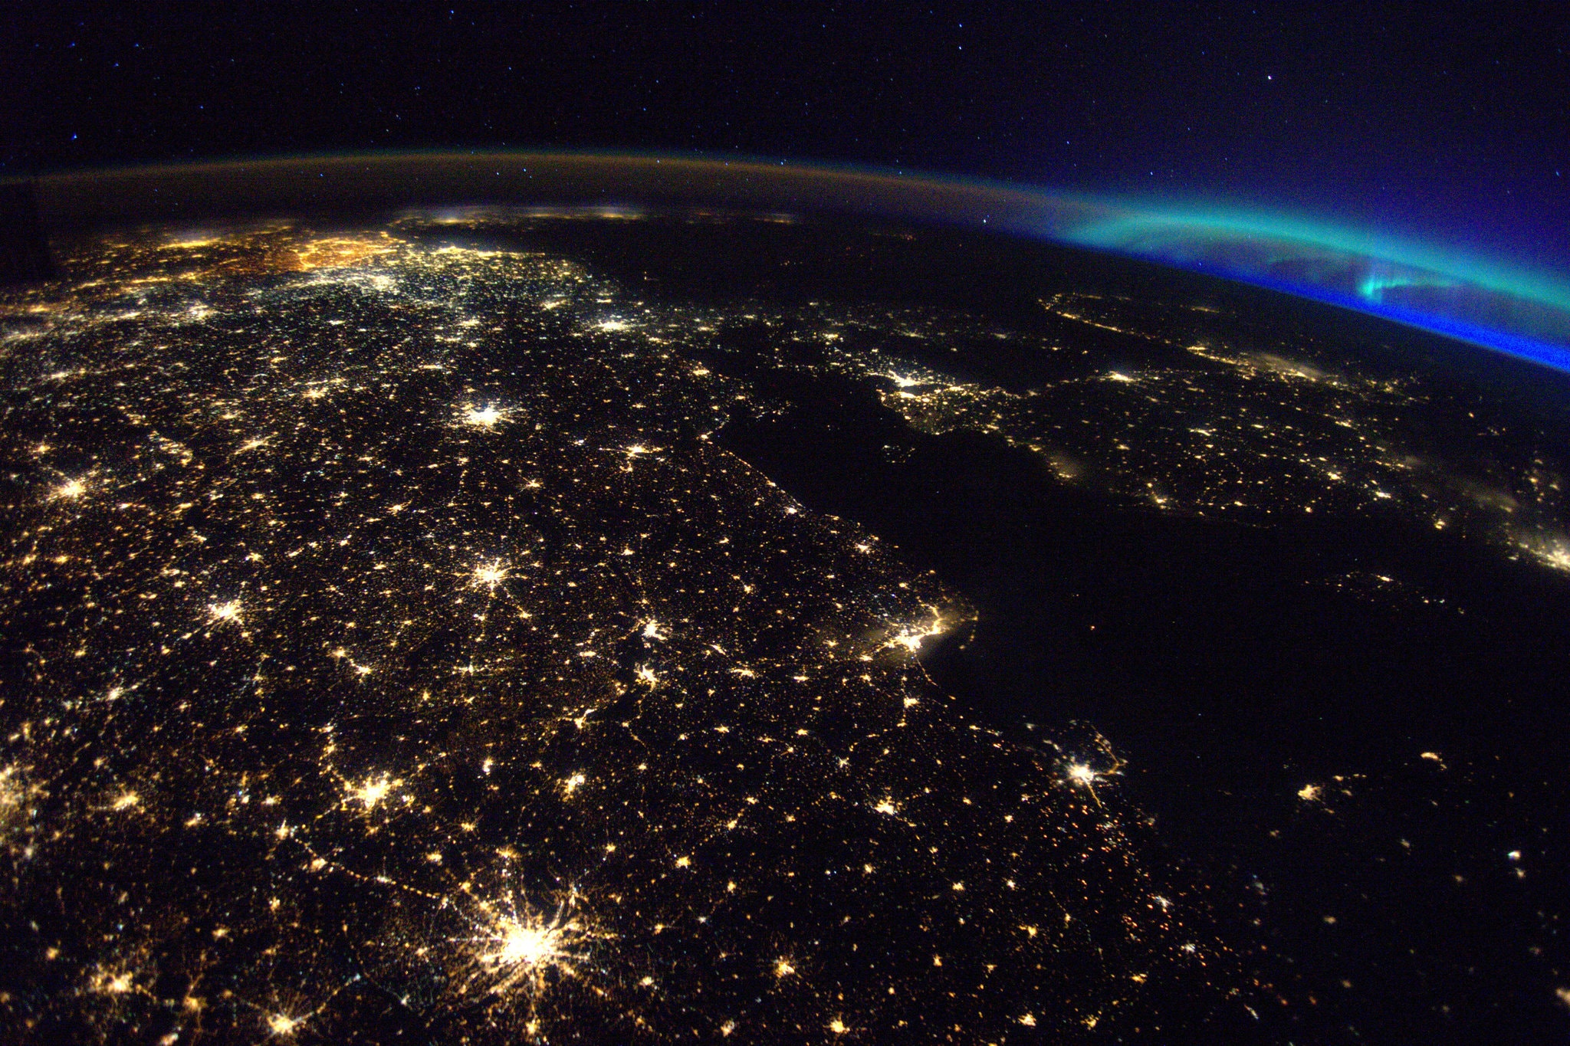
Team Maven SPOT THAT FIRE V2.0
Matt Yee Kevin Li Micheal Chung
Michael Thompson Budi P Chen Benjamin De Jager
Isiah Santala Joshua C Elder Steven Fischbach

Slide 3
Data Sources
Earth Observatory Natural Event Tracker (EONET)
Fire Information for Research Management System (FIRMS)

Slide 4
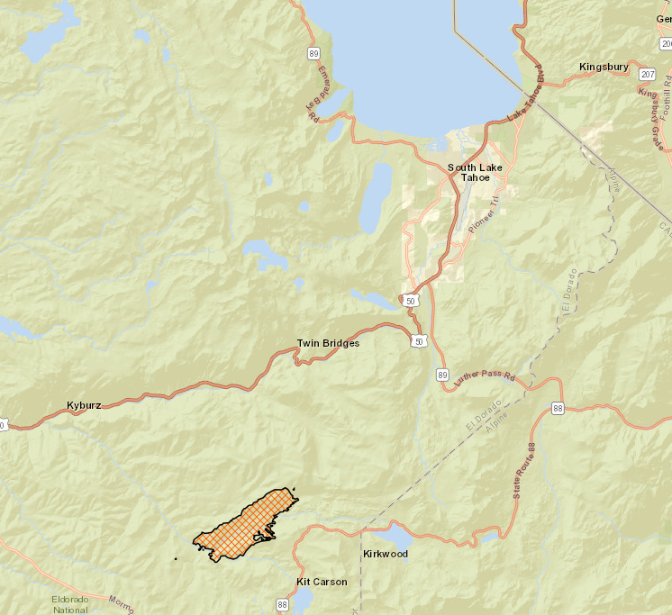
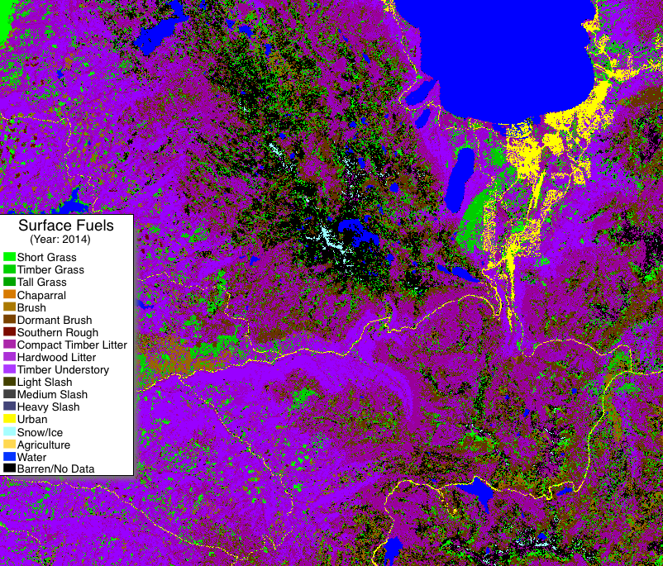
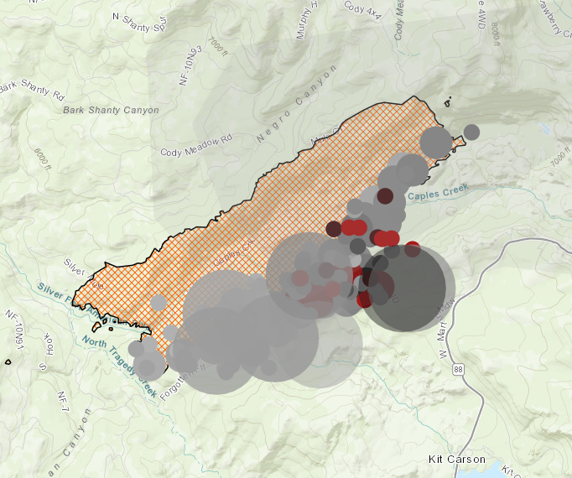
Propagation – How Fires Spread
There are many, many, many, many variables…
Fuel + Heat + Oxygen = A big mess!!!
Let’s look at two ways that fires can spread
Radiated heat increasing temperature of surrounding fuel source

Slide 5
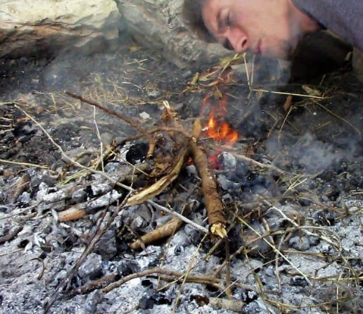
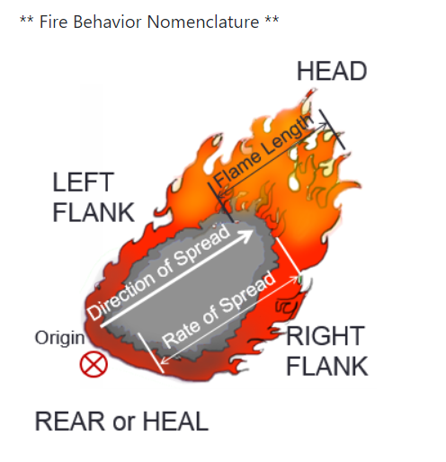
Propagation – How Fires Spread (cont.)
Wind matters too, right?
Yes, but…..is it helping or hurting?

Slide 6
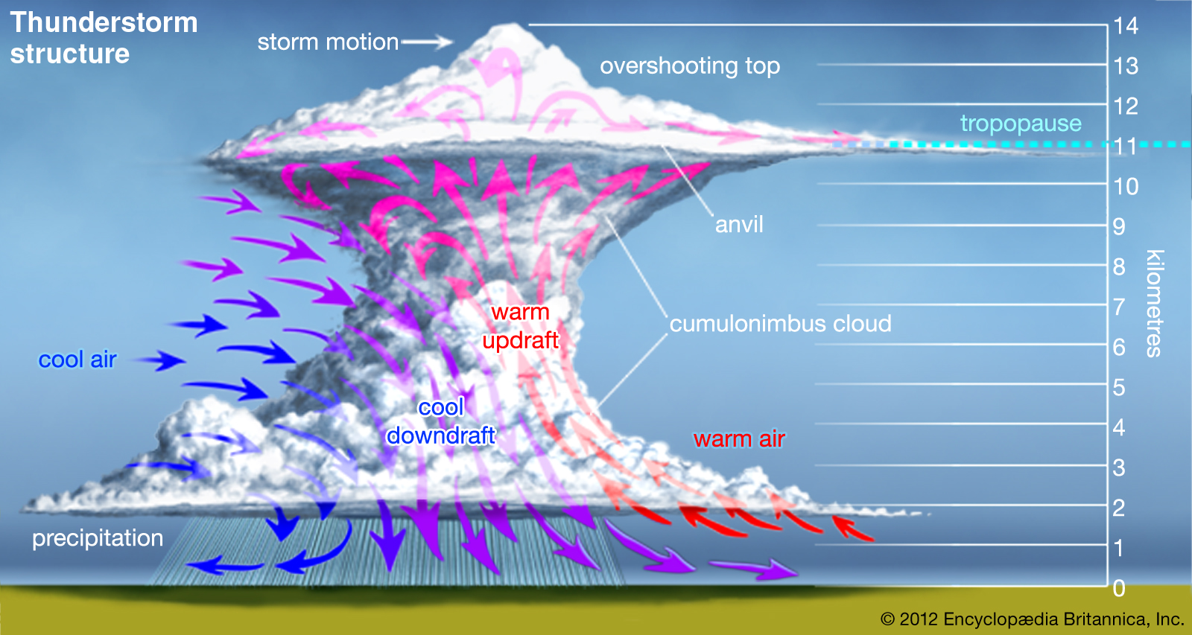
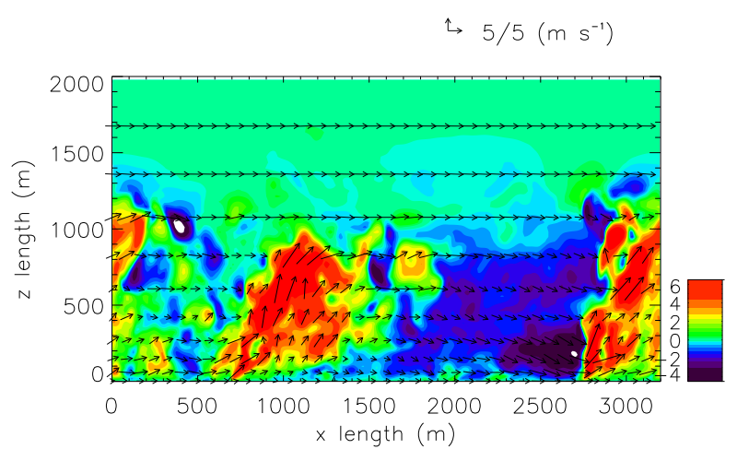
Winds Are Pushing AND Providing Oxygen…
It’s like a thunderstorm…
…but it’s on fire!!!

Slide 7
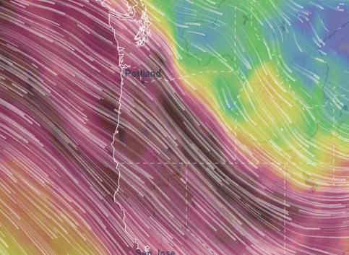
The Bigger the Fire…
The higher levels of winds that will act upon it
15,000 ft @ 80 mph or more

Slide 8
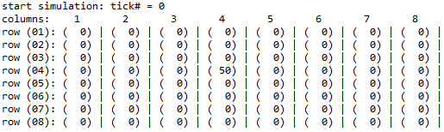
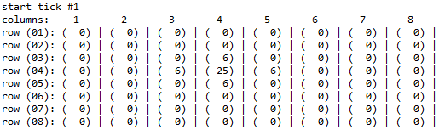
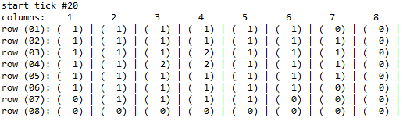
We Started With a Model
First version is designed to show radiating heat

Slide 9
We Started With a Model
Next step would be to overlay dominant winds

Slide 10
We Started With a Model
Future work will have different layers of wind speeds and directions

Slide 11
We Started With a Model
Future work will model vertical development

Slide 12
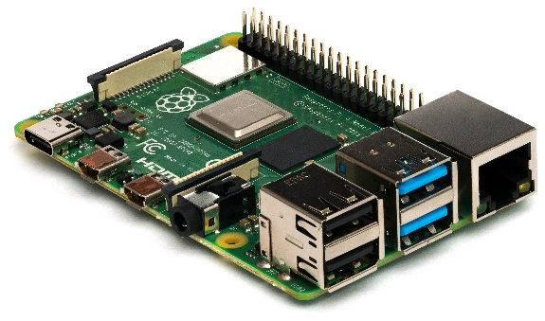
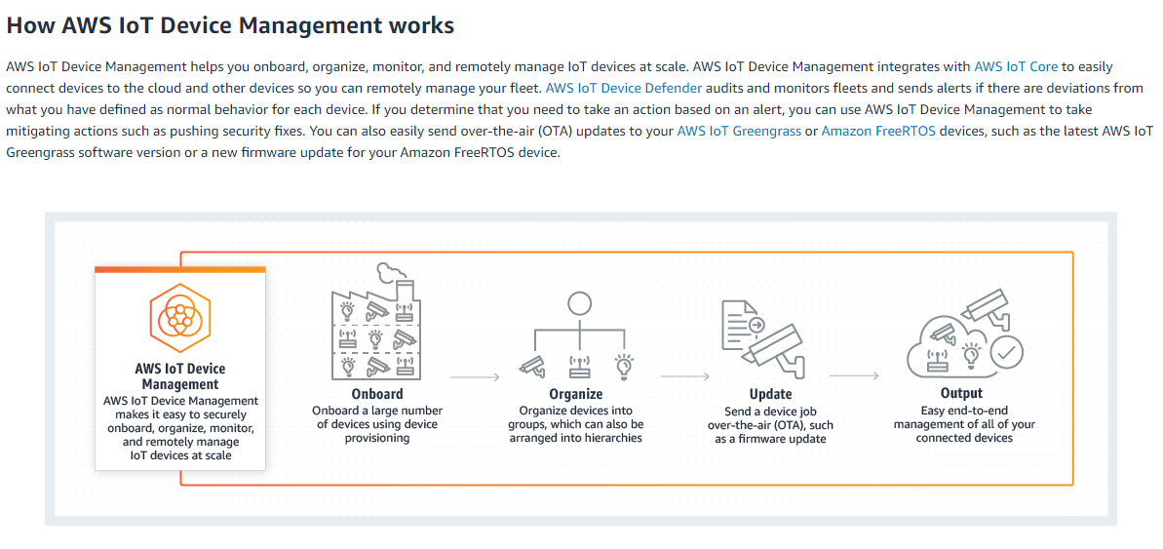
We Need Better Data… …and more Pi…
More information about temperature, pressure, and wind velocity

Slide 13
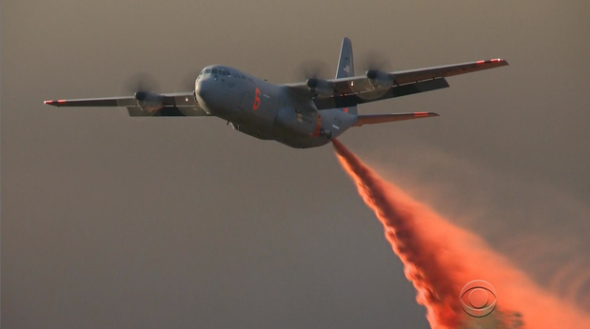
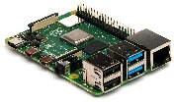
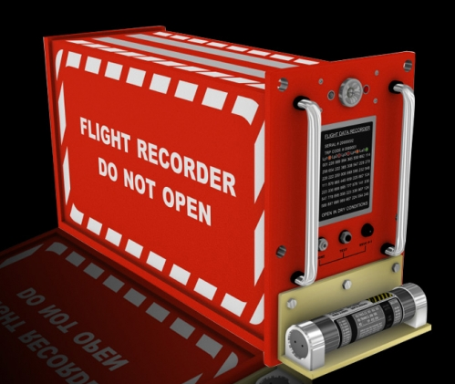

IOT ? You mean Internet of PI!
More information about temperature, pressure, and wind velocity

Slide 14
Additional Sources of Data
Use existing networks:
Weather Underground (Wundermap data)
LaCrosse (WIFI enabled weather stations)
PressureNet (University of Washington)

Slide 15
Team Maven, Thanks You! “Boiling the Sky”
Matt Yee Kevin Li Micheal Chung
Michael Thompson Budi P Chen Benjamin De Jager
Isiah Santala Joshua C Elder Steven Fischbach

